Slide 1
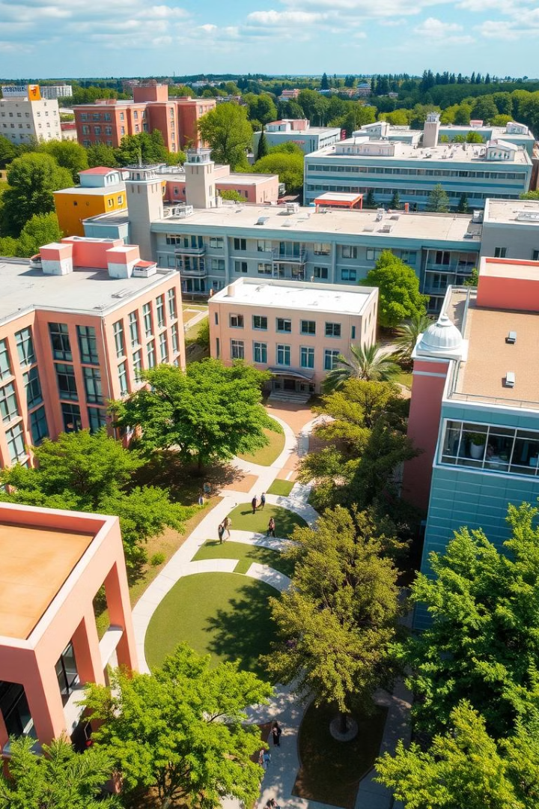
Northeastern University Integrated Ecosystem Model
This presentation outlines a unified framework for streamlining operations across Northeastern University's academic, financial, emergency, and health services.
Group 8 Monday Batch Aksh Talati - 002342012 Bhargav Gandhi - 002310643 Varana Navadiya - 002308207

Slide 2
Addressing the Fragmentation Challenge
Siloed Operations
Impact on Stakeholders
Current systems are disconnected, creating inefficiencies and a fragmented user experience.
Students, staff, and faculty face delays in accessing services and navigating complex processes.

Slide 3
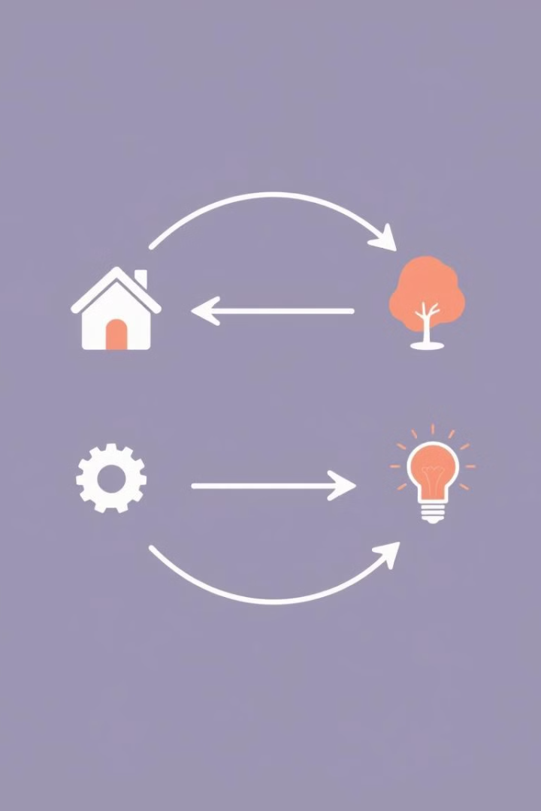




Enterprise Ecosystem: Roles and Interactions
University Enterprise
Bank Enterprise
Manages academic operations, student resources, and faculty activities.
Handles student loans, financial transactions, and payroll processing.
Emergency Enterprise
Pharmacy Enterprise
Provides security services, crime reporting, and emergency response.
Manages student medication purchases and inventory.

Slide 4
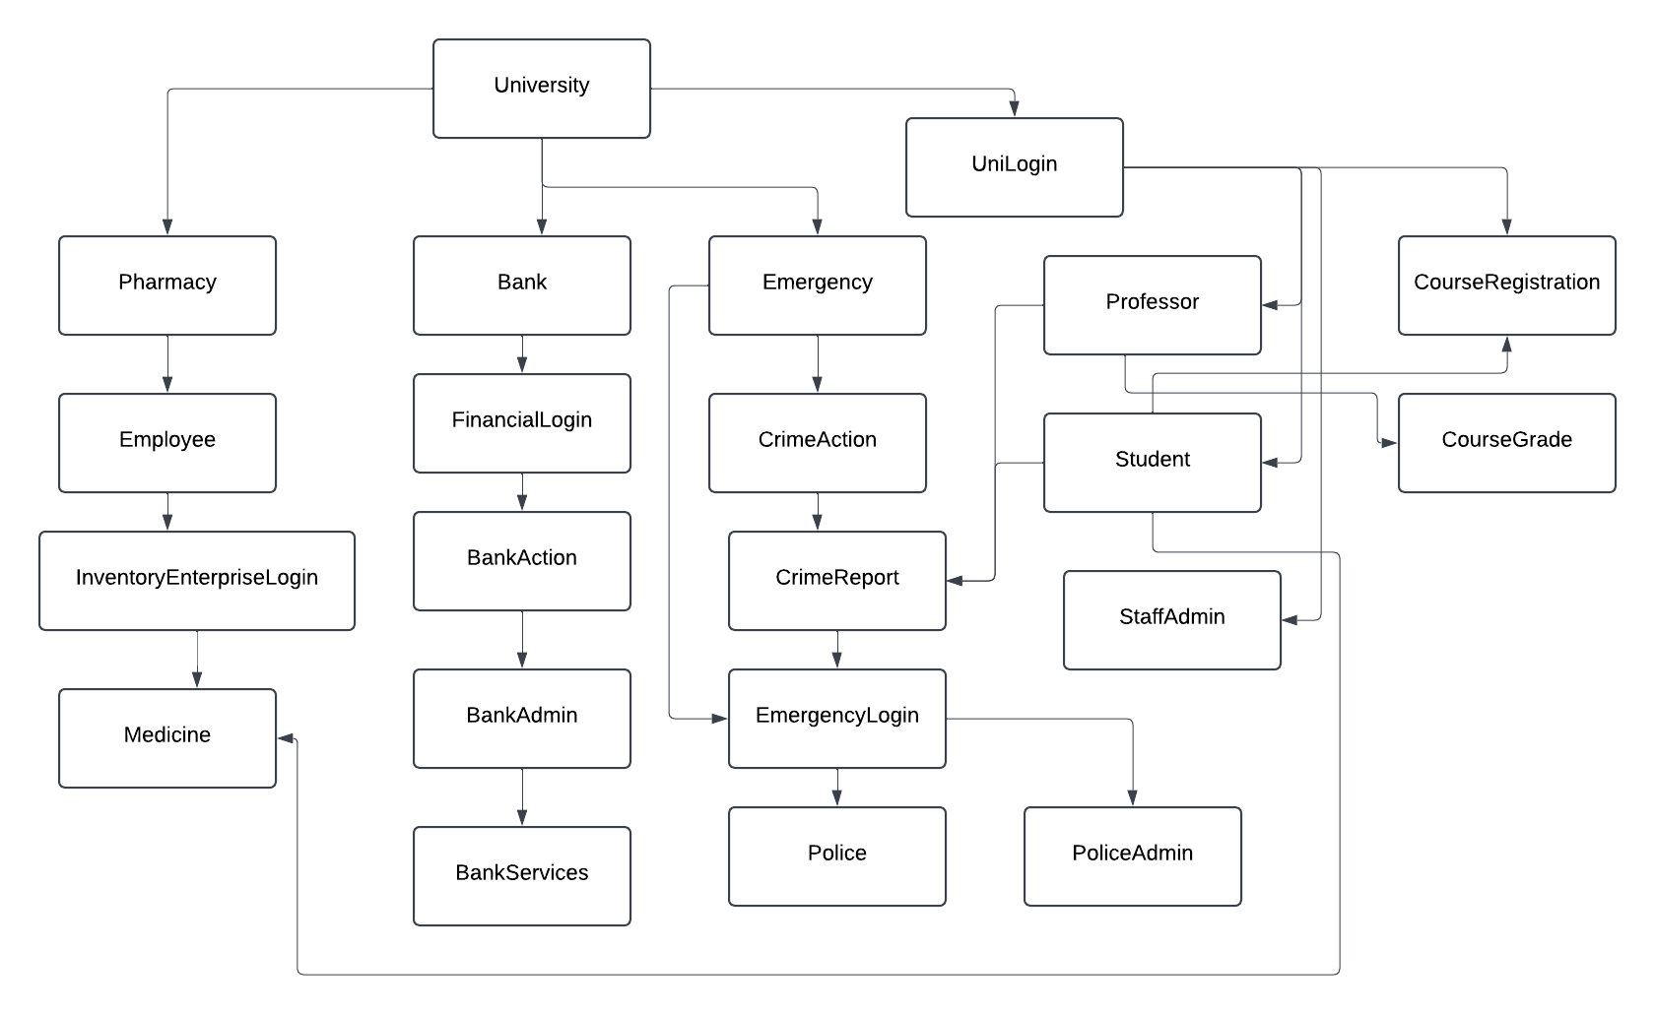
UML Diagram: Visualizing Interactions

Slide 5

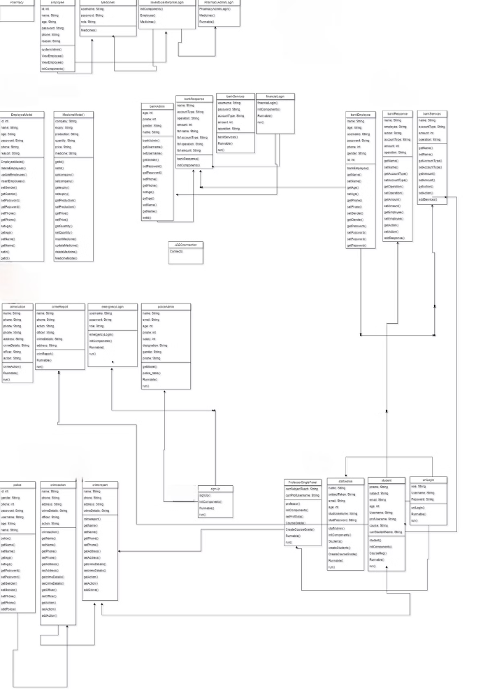
Class Diagram: Structural Overview
The class diagram defines key system components, such as University, Bank, Emergency, and Pharmacy. Each class
includes attributes and methods reflecting its functions and interactions.

Slide 6

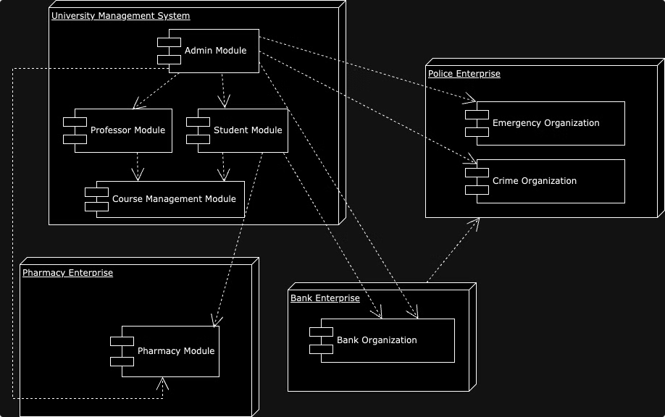
Component Diagram: System Architecture
The component diagram outlines the modular structure of the system, with modules for core university functions, banking, emergency services, and pharmacy operations.

Slide 7

Benefits of the Integrated Ecosystem
Centralized Management
Streamlined Workflows
Simplifies processes for loans, crime reporting, and medicine purchases.
Provides a unified platform for managing all university services.
Scalability and Future Enhancements
Secure Data Handling
Guarantees data security and integrity across all enterprises.
Modular design supports growth and integration of new services.

Slide 8

Towards a Smarter University Ecosystem
1
2
3
Expand services to external hospitals and financial institutions.
Develop predictive analytics for emergencies and financial management.
Implement real-time notifications and dashboards for students and s

Slide 9
Thank You, Let's Begin With The Demo
We appreciate your time and consideration.

